Slide 1
CH201 PROJECT
TEAM:
THE HIDDEN MIST
Mohamed Mazhar Laljee(2019CHB1051)
Shivam Pandey(2019CHB1055)
Shubham Sonawane(2019CHB1056)
Suryansh Pratap Singh(2019CHB1057)

Slide 2
Problem Statement
Analysis of Production of Hydrogen by Steam Methane Reforming and Electrolysis of Water to determine the less polluting and more cost efficient method.

Slide 3
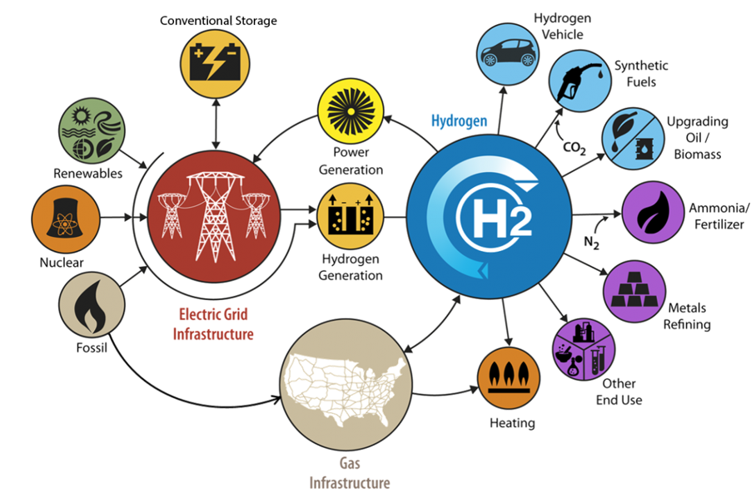
WHY HYDROGEN?

Slide 4
Strategy
Study of research papers.
Use of available data for calculations.
Determining the energy cost of running the processes.
Data visualization and use of softwares.

Slide 5
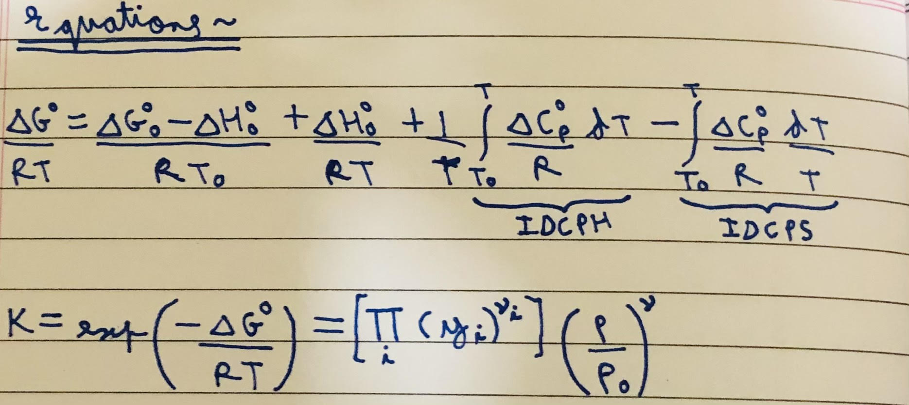
Tools and Equations Used
01
Python: For process Calculations and Data Visualization.
02
DWSIM: For Creating process models.
03
fx-991 ES PLUS: For hand Calculations and Validation of results.
04

Slide 6
Steam Methane Reforming
Steam Methane Reforming is a method of producing syngas (Carbon monoxide + Hydrogen) by reaction of methane with steam. Commonly, we use natural gas as the feedstock and Nickel as the catalyst.
The main purpose of this method is hydrogen production.
The Reaction is represented as: CH₄ + H₂O → CO + 3H₂
The Reaction is strongly Endothermic.
Generally, conditions employed for this reaction are temperatures between 700-1000 degree C, pressures between 3-25 bar and 3:1 steam to methane molar ratio.

Slide 7
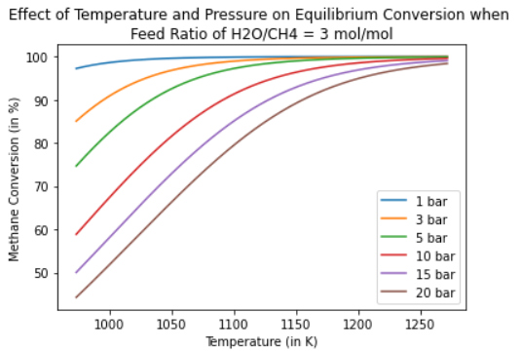
Calculations and Thermodynamic Analysis using Python
As can be seen from the plot generated using Python, the equilibrium conversion of methane increases with increase in temperature (endothermic reaction) and decreases with increase in pressure (more moles of gas on product side). [Le Chatelier’s Principle]
Using Python, the enthalpy change of the reaction at 850 degree C/ 1123.15 K and 1 bar with 1 mol CH₄ and 3 mol liq. H₂O as the feed comes out to be 499259.229435 J.
The equilibrium conversion of methane is found to be 99.926330 % and the corresponding hydrogen production is 2.99779 mol.

Slide 8
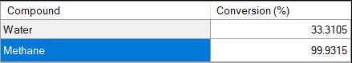
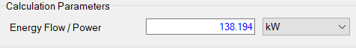
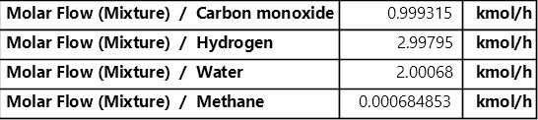
Calculations and Thermodynamic Analysis using DWSIM
At the same process conditions and feed ratio as above, using DWSIM, equilibrium conversion of methane turns out to be 99.9315 %
The feed used was 1 kmol/h CH₄ + 3 kmol/h H₂O, hence the energy/enthalpy change value of 138.194 kW is scaled to obtain the enthalpy change for a feed of 1 mol CH₄ + 3 mol H₂O. The value turns out to be 138.194*1000*3600/1000= 497498.4 J.
The corresponding hydrogen production is 2997.95/1000=2.99795 mol. Clearly, the values obtained using the two methods are in agreement with each other.

Slide 9
Cost Analysis for Steam Methane Reforming
Total energy required for steam methane reforming reaction at the above conditions= 499259.229435 J
Energy required in J per gram of H₂ produced = 499259.229435/(2*2.99779) = 83271.2147 J
Energy required in kWh per gram of H₂ produced = 83271.2147/(3600*1000) = 0.02313 kWh
Energy required in kWh per kg of H₂ produced = 0.02313*1000 = 23.13 kWh
Average cost of state electricity supply in India = Rs 5.43/kWh
Cost of electricity to produce 1 kg of H₂ by steam methane reforming (energy cost) = 5.43*23.13 = Rs 125.6

Slide 10
Electrolysis of Water (Alkaline)
Alkaline water electrolysis is a process which uses a strong base as an electrolyte for the production of hydrogen.
Nickel (Ni) is generally used as an electrode material due to its low cost, efficient activity, and accessibility.
Potassium hydroxide (KOH) is normally used in alkaline water electrolysis, thus avoiding the corrosion problems caused by acid electrolytes.
Electrochemical reactions occurring at respective electrodes are:
1) Cathode: 2 H₂O + 2 e⁻→ H₂+ 2 OH⁻ (E₀ = −0.83 V vs. SHE) 2) Anode: 2 OH⁻→ ½ O₂ + H₂O + 2 e⁻ (E_{o} = 0.40 V vs. SHE) 3) Overall reaction is: H₂O → H₂ + ½ O₂ (E_{o}= −1.23 V vs. SHE)

Slide 11
Calculations and Thermodynamic Analysis
The equilibrium of reversible cell potential is obtained by subtracting the equilibrium potential of the left-hand side electrode from that of the right-hand side one i.e, Ee_{cell} = Ee(R)− Ee(L) and is related to the Gibbs free energy change of the overall cell reaction, ΔG_{cell}= − n*F*Ee _{cell} Where ΔG(cell) = ΔG(product) - ΔG(reactant) & for calculating we will use overall reaction.
W = PΔV = (101.3 x 10³ Pa)(1.5 moles)(22.4 x 10⁻³ m³/mol)*298/273 = 3715 J ΔU = ΔH - PΔV = 285.83 kJ - 3.72 kJ = 282.1 kJ ΔG = ΔH - TΔS = 285.83 kJ - 48.7 kJ = 237.1 kJ As here ΔG >0 so we have to apply potential greater than E_{cell} to drive this chemical reaction
Property | H₂O | H₂ | 0.5 O₂ | Change
Enthalpy | -285.83 kJ | 0 | 0 | ΔH = 285.83 kJ
Entropy | 69.91 J/K | 130.68 J/K | 102.57 J/K | TΔS = 48.7 kJ

Slide 12
Cost Analysis for Water Electrolysis
Total electrical energy required to produce one mole of H₂ = ΔG = 237.1 kJ
Total energy in kWh = 237.1*1/3600 = 0.0659 kWh
Average cost of state electricity supply in India = Rs 5.43/kWh.
Cost of electricity to produce one mole of H₂ = 0.0659*5.43 = Rs 0.35
Cost of electricity to produce one kg of H₂ using the electrolysis process (energy cost) = (0.35*1000)/2 = Rs 178.97

Slide 13
Conclusions and Future work
The above analysis led us to the conclusion that hydrogen production by Steam Methane Reforming is more cost-effective than by Electrolysis of Water. However, further study of electrolytic processes might help us innovate and reduce costs.
In future, we will continue the analysis of hydrogen which was produced by alkaline electrolysis and we will also analyse other electrolysis processes, something which could not be done now due to unavailability of sufficient data. Dr. Oystein Ulleberg (ResearchGate) has successfully simulated this process and obtaining the full text of the research paper and the simulation model would be of great help in order to pursue the analysis.

Slide 14
Roles of Team Members
Mohamed Mazhar Laljee:
(2019CHB1051)
Content editing, analysis of hydrogen production by steam methane reforming, Python and DW-SIM calculations.
Shivam Pandey:
(2019CHB1055)
Analysis of hydrogen production by electrolysis of water, cost analysis, Python calculations.
Shubham Sonawane:
(2019CHB1056)
Analysis of production of hydrogen by electrolysis of water, content writing, DW-SIM calculations.
Suryansh Pratap Singh:
(2019CHB1057)
PPT editing, analysis of hydrogen production by steam methane reforming, DW-SIM calculations, cost analysis.

Slide 15
References
https://www.energy.gov/eere/fuelcells/hydrogen-production-natural-gas-reforming
https://www.researchgate.net/publication/262617097_Hydrogen_production_by_alkaline_water_electrolysis
https://www.intechopen.com/books/nanostructures-in-energy-generation-transmission-and-storage/proton-exchange-membrane-water-electrolysis-as-a-promising-technology-for-hydrogen-production-and-en
https://www.sciencedirect.com/topics/engineering/hydrogen-production-cost#:~:text=The%20cost%20of%20energy%20is,(given%20similar%20energy%20costs).

Slide 16

THANK YOU!

